Slide 1
Apache Kafka and real-time data streaming
CSE707: Distributed Computing System
Faisal Rafiq khan
Presented by
Group #2
21166020 | Md. Tarikul Islam

Slide 2
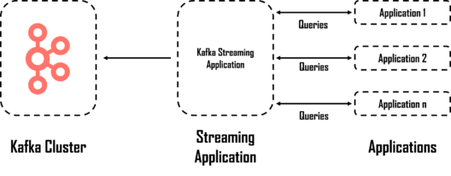
Introduction
A challenge with the continuously rising amount of data
Big data technology as real-time and streaming analytics
Open source stream framework which is written in Java and Scala for building application and micro-services

Slide 3
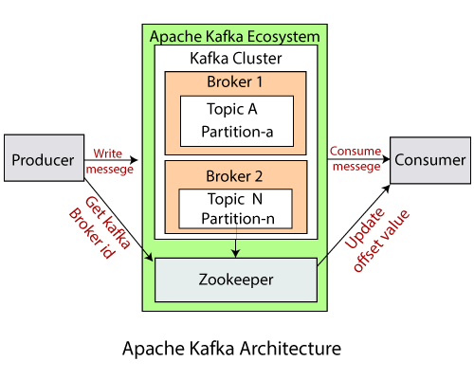
Apache Kafka Architecture
Major terms of Kafka (Topics, records, brokers)
Publish subscribe messaging system with four APIs i.e., producer API, consumer API, streams API and connector API.
Zookeeper to perform simultaneous reads, writes, and acts.

Slide 4

Partition and Offsets
Kafka Topic
How many partition ?
01011101010010
10001010110101
01010010101111
11010010010100
00101010010101
Locating a message:
Topic name + Partition No. + Offset

Slide 5
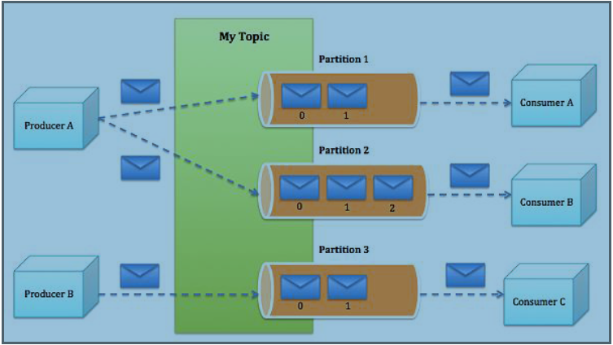
Real-time streaming in Kafka
Kafka builds on publish-subscribe model with a messaging queue system.
Only one of the consumers within a consumer-group reads each particular message.
Multiple consumer-groups can read from the same set of topics, and at different times so that it avoids double reading of records.

Slide 6
Conclusion
New startups or enterprises fear to work with Kafka (Do not have complete set of monitoring tools).
Message tweaking issues.
Solve low-latency ingestion of large amounts of event data.
Power the core business from small to large-scale use cases that handle millions events per second.

Slide 7
References
B. Svingen, “Publishing with Apache Kafka at The New York Times”, accessed 25 Aug, 2020.
“Apache Kafka for Item Setup”, Medium.com, accessed 28 Aug, 2020.
Javed Ahmed Shaheen, “Apache Kafka: Real Time Implementation with Kafka Architecture Review” accessed 4 Sep, 2020.
“Data Streaming With Apache Kafka”, Medium.com, accessed 28 Aug, 2020.
LinkedIn Engineering Blog, accessed 22 Aug, 2020.
Understanding Kafka — A Distributed Streaming Platform”, Medium.com accessed 7 Sep, 2020.

